Slide 1
Key Stage 1
National Curriculum
Assessments

Slide 2
The SAT Assessments
At the end of Year 2, children will take assessments in:
- Reading (to inform our teacher-assessed level)
- Maths (to inform our teacher-assessed level)
- Grammar, Punctuation and Spelling (to inform our teacher-assessed level in Writing).
All assessment are due to take place in May this year.

Slide 3
Reading Assessment
The Reading Test consists of two separate papers:
Paper 1 – consists of a combined reading prompt and answer booklet. The paper includes a list of useful words and some practice questions for teachers to use to introduce the contexts and question types to pupils. The test takes approximately 30 minutes to complete, but is not strictly timed.
Paper 2 – consists of an answer booklet and a separate reading booklet. There are no practice questions on this paper. Teachers can use their discretion to stop the test early if a pupil is struggling. The test takes approximately 40 minutes to complete, but is not strictly timed.
The texts will cover a range of poetry, fiction and non-fiction.

Slide 4
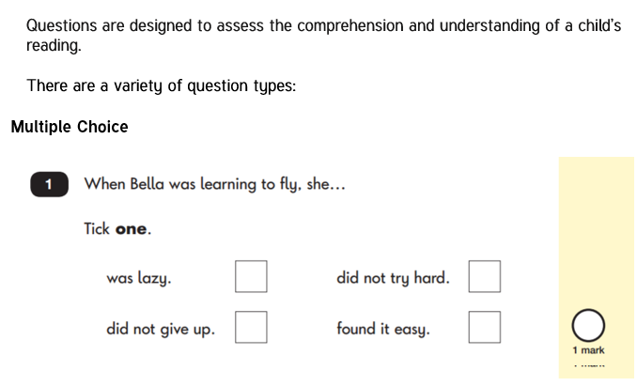
Reading: Sample Questions

Slide 5
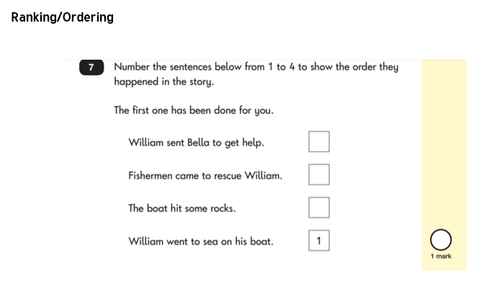
Reading: Sample Questions

Slide 6
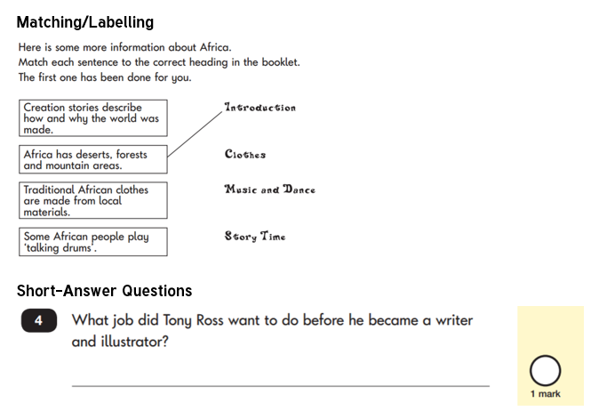
Reading: Sample Questions

Slide 7
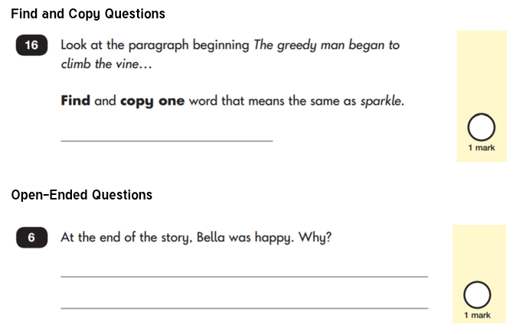
Reading: Sample Questions

Slide 8
Spelling, Punctuation and Grammar
This year, the spelling, punctuation and grammar test is optional for all Year 2 classes. We will still administer the assessment at Kingsway in order to inform out teacher-assessed writing judgements.
The test consists of 2 separate papers:
Paper 1: SPELLING
The pupils spell 20 missing words within a test booklet. The test is expected to take approximately 15 minutes to complete, but is not strictly timed.
Paper 2: GRAMMER, PUNCTUATION AND VOACBULARLY
A combined question and answer booklet focusing on pupils’ knowledge of grammar, punctuation and vocabulary.
Pupils will have approximately 20 minutes to complete the questions in the test paper, but it is not strictly timed.

Slide 9
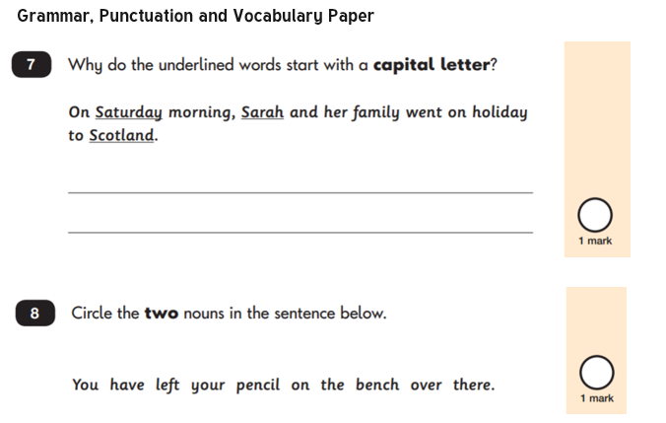
Spelling, Punctuation and Grammar: Sample Questions

Slide 10
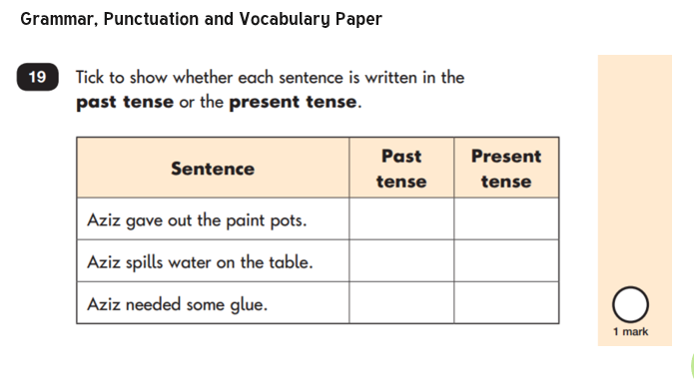
Spelling, Punctuation and Grammar: Sample Questions

Slide 11
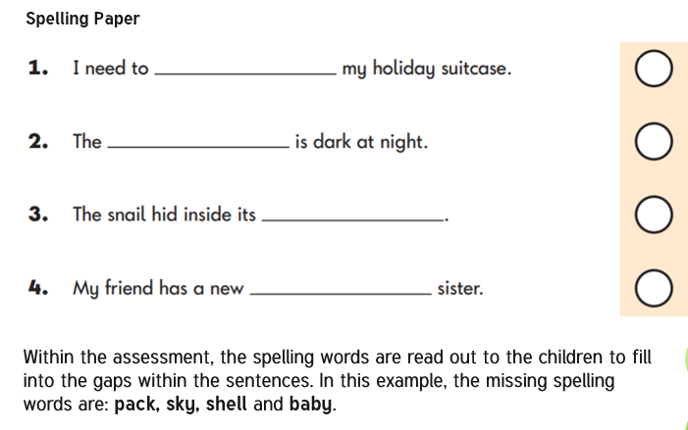
Spelling, Punctuation and Grammar: Sample Questions

Slide 12
Maths
Children will sit two tests: Paper 1 and Paper 2:
Paper 1: Arithmetic - lasts approximately 20 minutes (but this is not strictly timed). It covers calculation methods for all operations.
Paper 2: Reasoning - lasts for approximately 35 minutes, which includes time for five aural questions. Pupils will still require calculation skills and questions will be varied including multiple choice, matching, true/false, completing a chart or table or drawing a shape. Some questions will also require children to show or explain their working out.

Slide 13
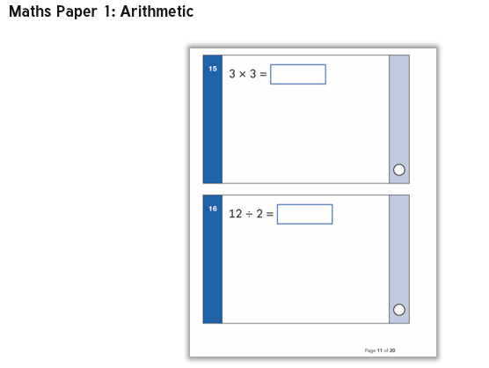
Maths

Slide 14
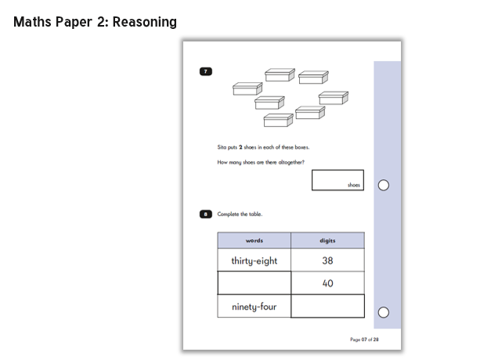
Maths

Slide 15
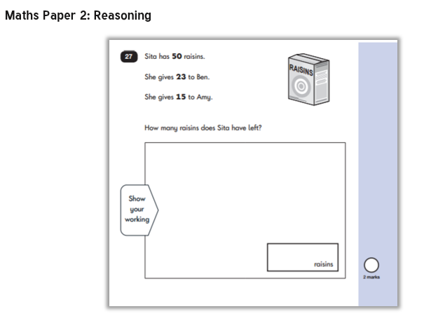
Maths

Slide 16
Assessment and Reporting
Children are described as working towards, working at and working at greater depth according to the Year 2 expectations of the curriculum.
The curriculum is rigorous and sets high expectations.
Test scores are reported as ‘scaled scores’.

Slide 17
Scaled Scores
What is meant by ‘scaled scores’?
It is planned that 100 will always represent the ‘national standard’.
Each pupil’s raw test score will therefore be converted into a score on the scale, either at, above or below 100.
The scale will have a lower end point somewhere below 100 and an upper end point above 100.
A child who achieves the ‘national standard’ (a score of 100) will be judged to have demonstrated sufficient knowledge in the areas assessed by the tests.

Slide 18
Scaled Scores: Examples
A child awarded a scaled score of 100 is judged to have met the ‘national standard’ in the area judged by the test.
A child awarded a scaled score of more than 100 is judged to have exceeded the national standard and demonstrated a higher than expected knowledge of the curriculum for their age.
A child awarded a scaled score of less than 100 is judged to have not yet met the national standard and performed below expectation for their age.
Marking guidance for KS1 tests will include conversion tables. Teachers will use these to translate pupil’s raw scores into scaled scores to see whether each pupil has met the national standard. Teachers will use the scaled scores to inform their teacher assessment judgements.

Slide 19
Teacher Assessments/Results
KS1 SATs tests are one part of evidence towards the whole teacher assessment.
They are marked in school, and an overall grading based on the whole year’s work will be made.
Moderation often takes place to ensure consistency across schools.

Slide 20
How you can help your child
First and foremost, support and reassure your child that there is nothing to worry about and that they should always just try their best. Praise and encourage!
Ensure your child has the best possible attendance at school.
Support your child with any homework tasks.
Reading, spelling and arithmetic (e.g. times tables) are always good to practise.
Talk to your child about what they have learnt at school and what book(s) they are reading (the character, the plot, their opinion).
Make sure your child has a good sleep and healthy breakfast every morning!

Slide 21
How you can help your child with Reading
Listening to your child read can take many forms:
First and foremost, focus developing an enjoyment and love of reading.
Enjoy stories together – reading stories to your child is equally as important as listening to your child read.
Read a little at a time but often, rather than rarely but for long periods of time!
Talk about the story before, during and afterwards – discuss the plot, the characters, their feelings and actions, how it makes you feel, predict what will happen and encourage your child to have their own opinions.
Look up definitions of words together – you could use a dictionary, the Internet or an app on a phone or tablet.
All reading is valuable – it doesn’t have to be just stories. Reading can involve anything from fiction and non-fiction, poetry, newspapers, magazines, football programmes, TV guides.

Slide 22
How you can help your child with Writing
Practise and learn weekly spelling lists – make it fun!
Encourage opportunities for writing, such as letters to family or friends, shopping lists, notes or reminders, stories or poems.
Write together – be a good role model for writing.
Encourage use of a dictionary to check spelling.
Allow your child to use a computer for word processing, which will allow for editing and correcting of errors without lots of crossing out.
Remember that good readers become good writers! Identify good writing features when reading (e.g. vocabulary, sentence structure, punctuation).
Show your appreciation: praise and encourage, even for small successes!

Slide 23
How you can help your child with Maths
Play times tables games/ TT Rockstars
Play mental maths games including counting in different amounts, forwards and backwards.
Encourage opportunities for telling the time.
Encourage opportunities for counting coins and money e.g. finding amounts or calculating change when shopping.
Look for numbers on street signs, car registrations and anywhere else.
Look for examples of 2D and 3D shapes around the home.
Identify, weigh or measure quantities and amounts in the kitchen or in recipes.
Play games involving numbers or logic, such as dominoes, card games,
draughts or chess.

